Slide 1
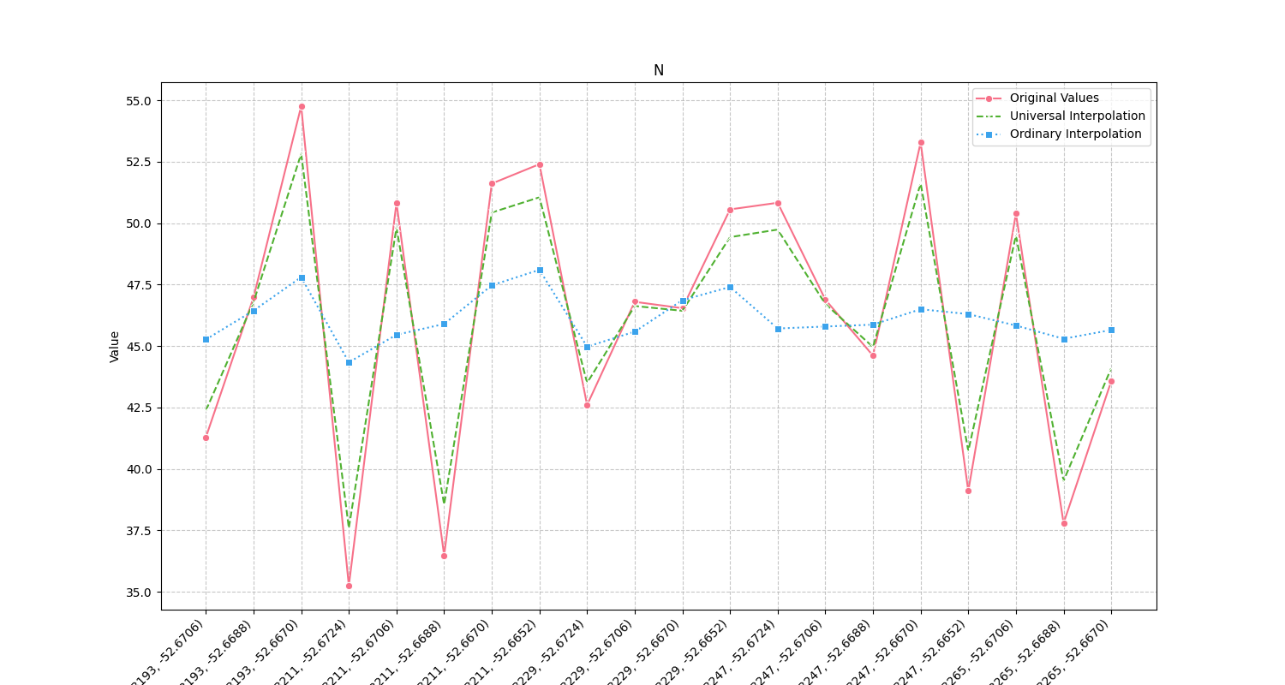
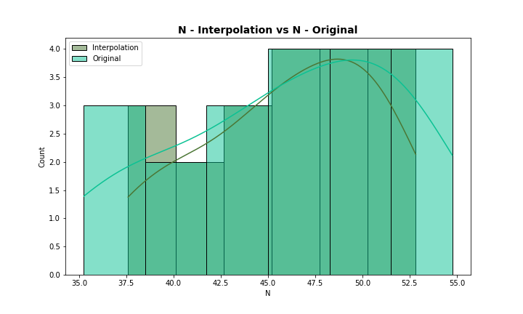
Analysis for column: N Model: UK
Interpolated Statistics:
mean 46.116091
std 4.574125
min 37.593214
25% 43.218087
50% 46.671085
75% 49.759041
80% 49.941849
85% 50.526019
90% 51.109876
95% 51.683610
99% 52.597770
Original Statistics:
mean 46.128000
std 5.867108
min 35.250000
25% 42.272500
50% 46.845000
75% 50.830000
80% 50.986000
85% 51.728500
90% 52.488000
95% 53.354000
99% 54.478800

Slide 2
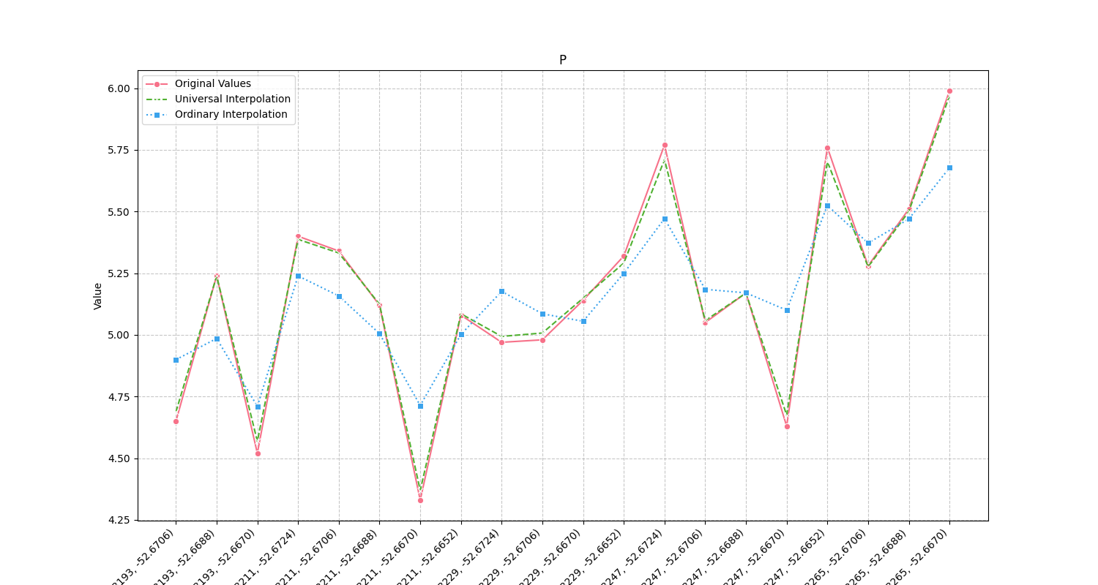
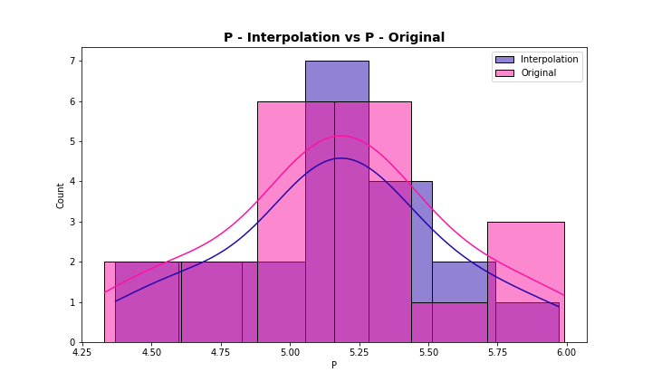
Analysis for column: P Model: UK
Interpolated Statistics:
mean 5.164852
std 0.396613
min 4.369581
25% 5.004180
50% 5.159018
75% 5.345885
80% 5.409760
85% 5.530398
90% 5.703685
95% 5.723624
99% 5.921085
Original Statistics:
mean 5.162500
std 0.423542
min 4.330000
25% 4.977500
50% 5.155000
75% 5.355000
80% 5.422000
85% 5.547500
90% 5.761000
95% 5.781000
99% 5.948200

Slide 3
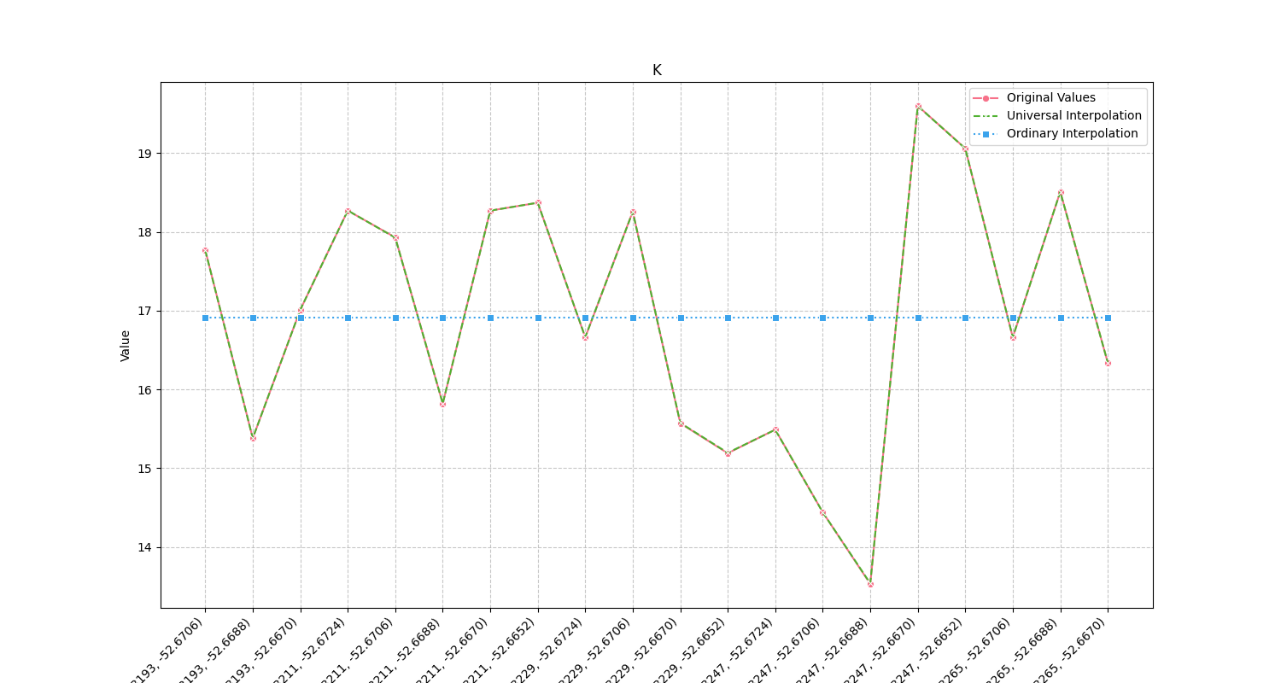
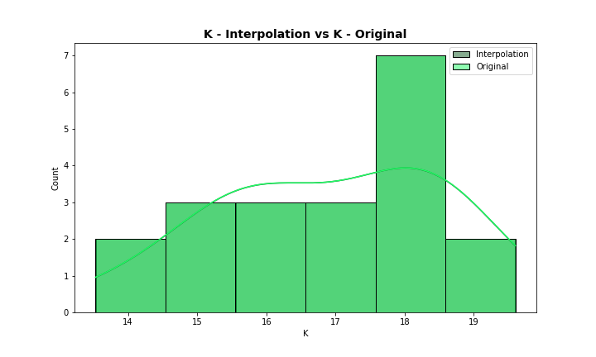
Analysis for column: K Model: UK
Interpolated Statistics:
mean 16.906907
std 1.654659
min 13.537132
25% 15.553191
50% 16.836479
75% 18.269967
80% 18.291255
85% 18.391375
90% 18.564668
95% 19.085905
99% 19.495068
Original Statistics:
mean 16.906500
std 1.656506
min 13.530000
25% 15.550000
50% 16.835000
75% 18.270000
80% 18.290000
85% 18.391000
90% 18.565000
95% 19.087000
99% 19.497400

Slide 4
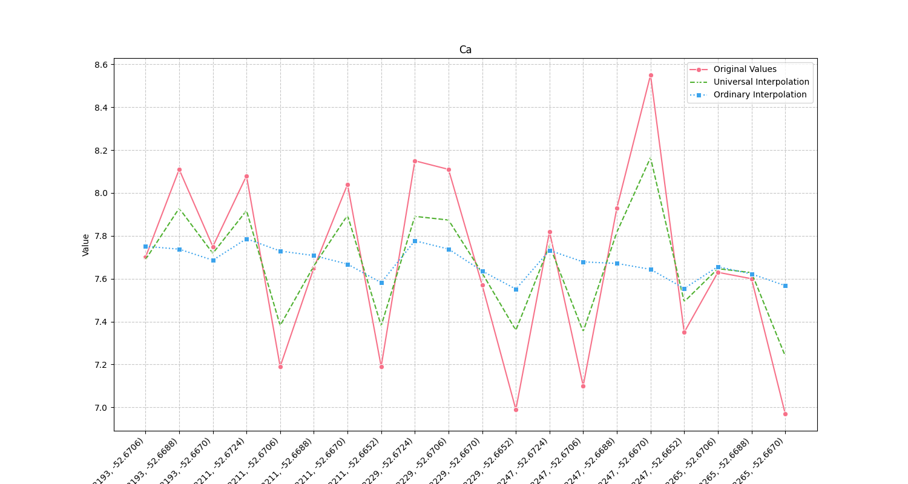
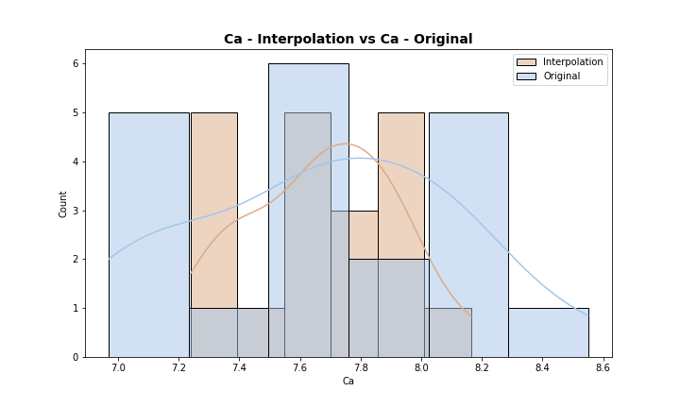
Analysis for column: Ca Model: UK
Interpolated Statistics:
mean 7.671063
std 0.243870
min 7.239756
25% 7.464926
50% 7.674301
75% 7.878010
80% 7.891904
85% 7.899178
90% 7.918939
95% 7.940419
99% 8.119976
Original Statistics:
mean 7.674000
std 0.438387
min 6.970000
25% 7.310000
50% 7.675000
75% 8.050000
80% 8.086000
85% 8.110000
90% 8.114000
95% 8.170000
99% 8.474000

Slide 5
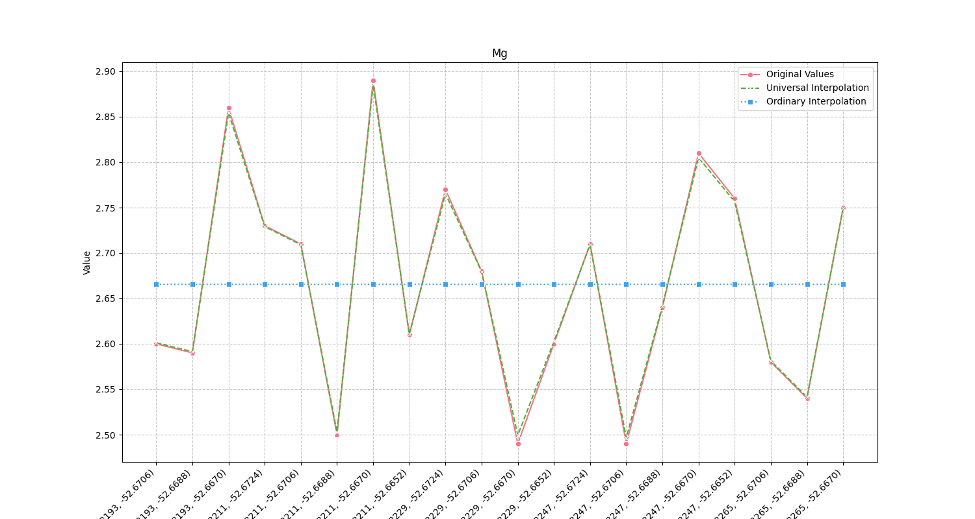
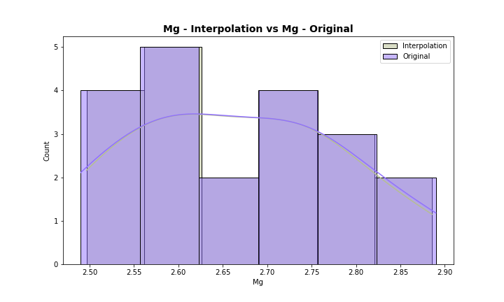
Analysis for column: Mg Model: UK
Interpolated Statistics:
mean 2.665576
std 0.116842
min 2.496498
25% 2.588898
50% 2.660530
75% 2.751098
80% 2.758298
85% 2.771300
90% 2.809982
95% 2.855982
99% 2.879777
Original Statistics:
mean 2.665500
std 0.120196
min 2.490000
25% 2.587500
50% 2.660000
75% 2.752500
80% 2.762000
85% 2.776000
90% 2.815000
95% 2.861500
99% 2.884300

Slide 6
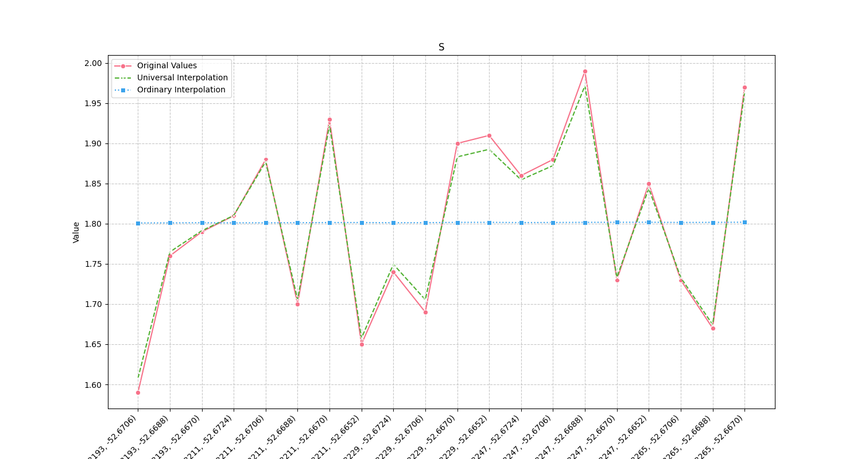
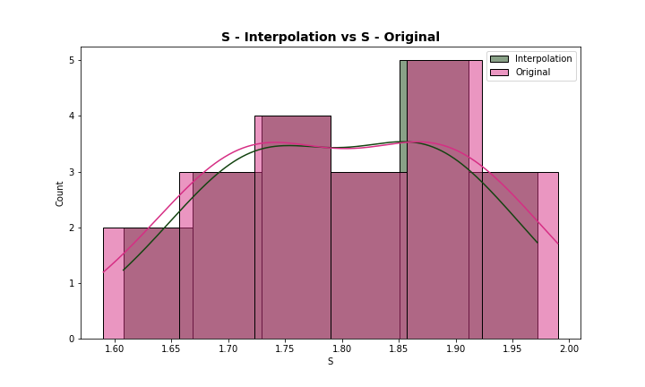
Analysis for column: S Model: UK
Interpolated Statistics:
mean 1.800836
std 0.104390
min 1.607632
25% 1.726227
50% 1.800813
75% 1.878824
80% 1.885172
85% 1.897257
90% 1.927259
95% 1.964269
99% 1.970388
Original Statistics:
mean 1.801500
std 0.113243
min 1.590000
25% 1.722500
50% 1.800000
75% 1.885000
80% 1.902000
85% 1.913000
90% 1.934000
95% 1.971000
99% 1.986200

Slide 7
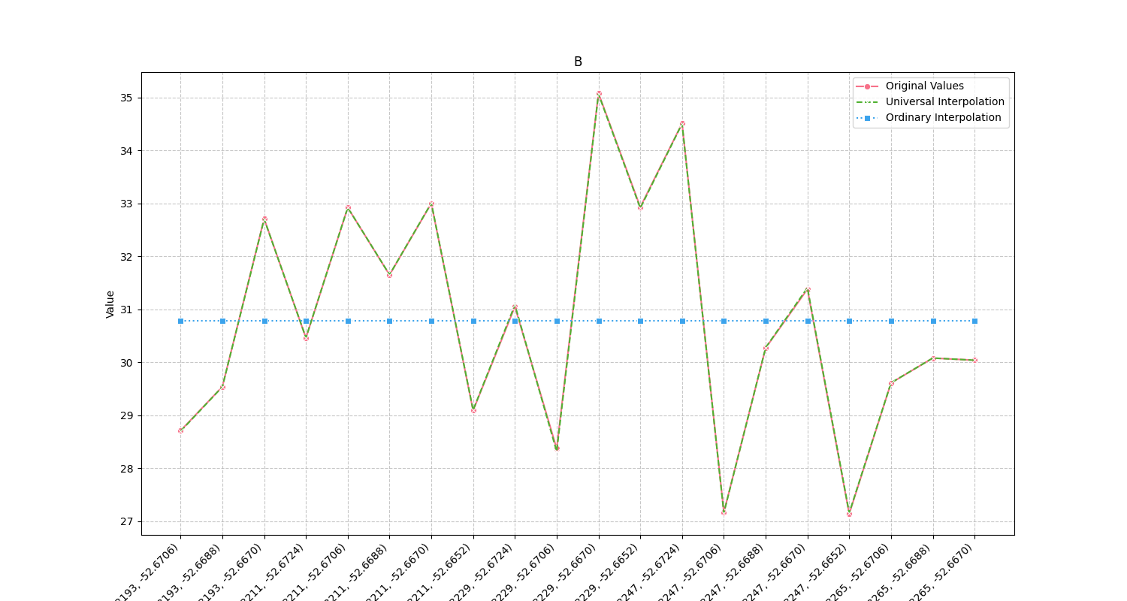
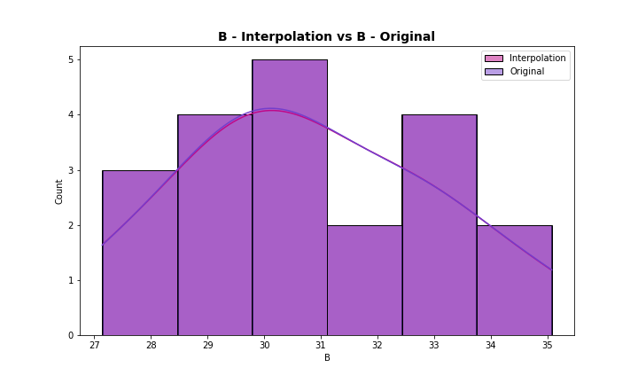
Analysis for column: B Model: UK
Interpolated Statistics:
mean 30.784645
std 2.235971
min 27.157026
25% 29.428249
50% 30.370432
75% 32.754794
80% 32.912301
85% 32.933430
90% 33.155614
95% 34.530501
99% 34.957505
Original Statistics:
mean 30.78550
std 2.23589
min 27.14000
25% 29.42750
50% 30.36500
75% 32.76250
80% 32.92200
85% 32.94050
90% 33.15100
95% 34.53850
99% 34.97170

Slide 8
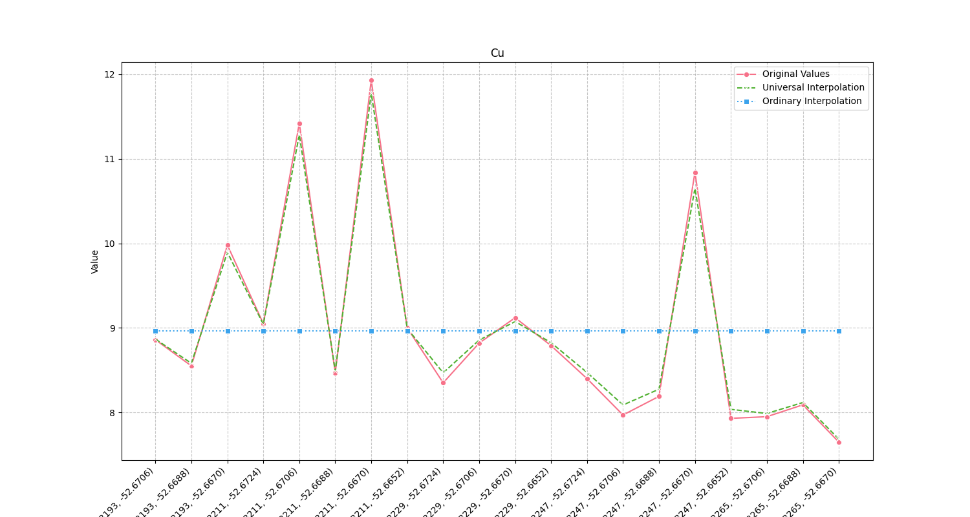
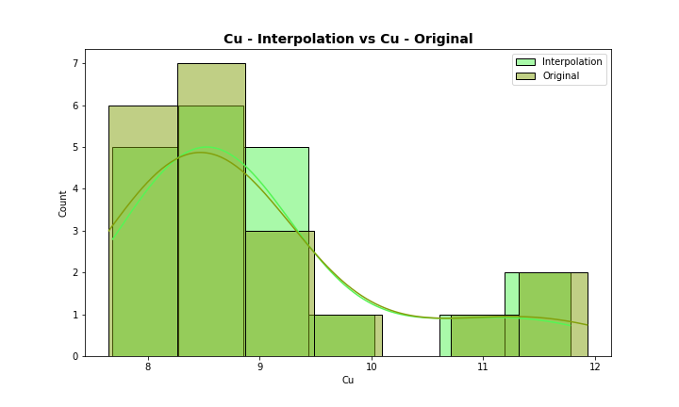
Analysis for column: Cu Model: UK
Interpolated Statistics:
mean 8.973304
std 1.108469
min 7.684603
25% 8.235547
50% 8.702749
75% 9.050242
80% 9.238968
85% 10.008161
90% 10.715354
95% 11.310129
99% 11.683685
Original Statistics:
mean 8.968000
std 1.186785
min 7.650000
25% 8.165000
50% 8.670000
75% 9.067500
80% 9.292000
85% 10.109000
90% 10.898000
95% 11.445500
99% 11.833100

Slide 9
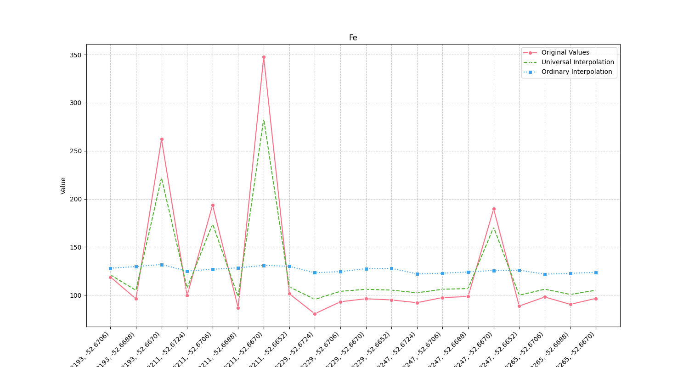
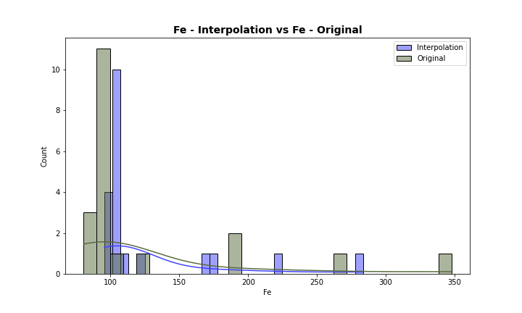
Analysis for column: Fe Model: UK
Interpolated Statistics:
mean 126.356129
std 49.176787
min 95.537404
25% 103.507278
50% 106.025008
75% 111.685143
80% 130.903375
85% 171.039040
90% 178.834889
95% 225.096139
99% 271.786925
Original Statistics:
mean 126.079500
std 69.663061
min 80.520000
25% 92.780000
50% 96.960000
75% 105.790000
80% 133.026000
85% 190.253000
90% 200.522000
95% 266.466000
99% 331.461200

Slide 10
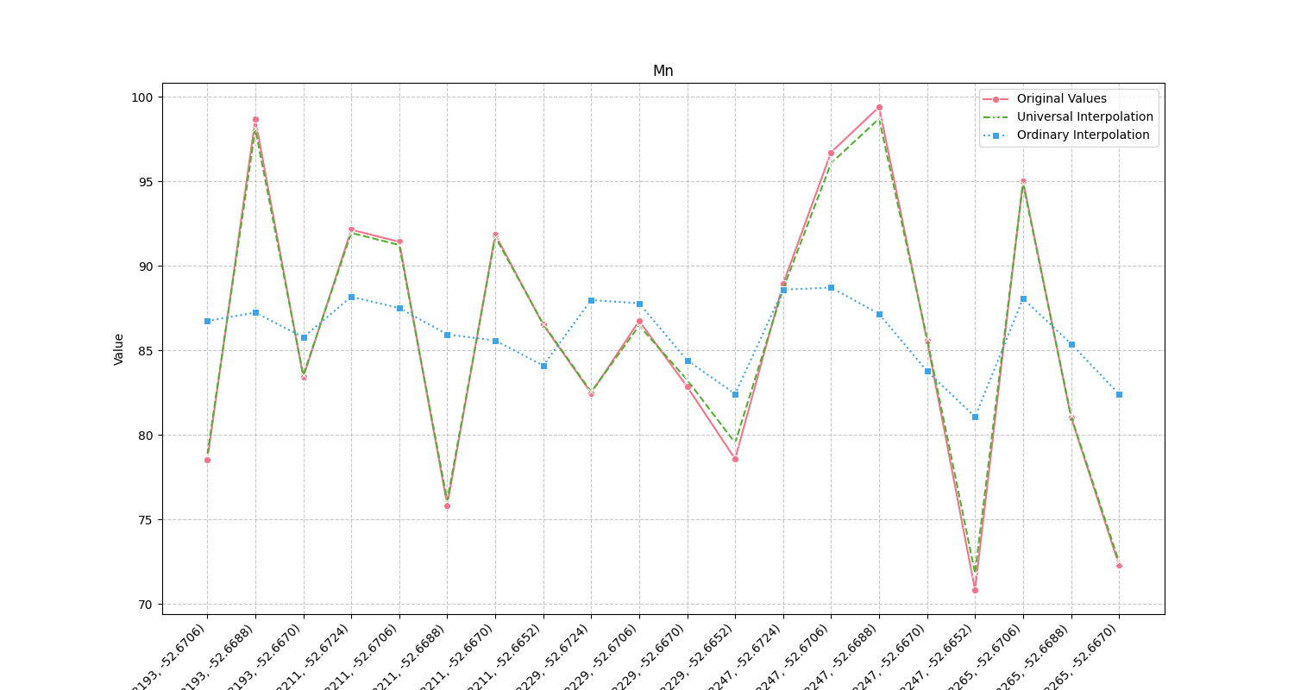
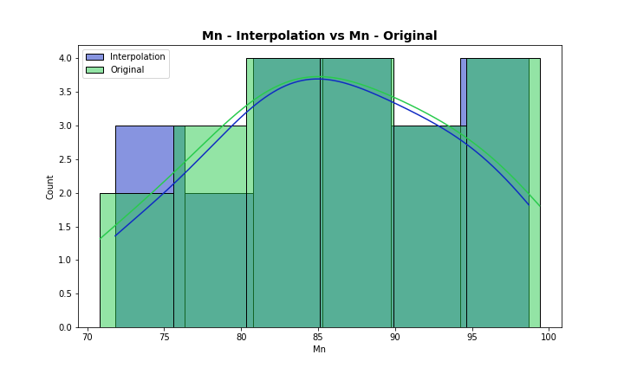
Analysis for column: Mn Model: UK
Interpolated Statistics:
mean 85.962987
std 7.998655
min 71.821018
25% 80.717155
50% 86.079060
75% 91.776732
80% 92.538540
85% 95.060582
90% 96.276817
95% 98.136052
99% 98.593628
Original Statistics:
mean 85.944000
std 8.375733
min 70.830000
25% 80.432500
50% 86.045000
75% 91.930000
80% 92.716000
85% 95.275000
90% 96.915000
95% 98.706500
99% 99.261300

Slide 11
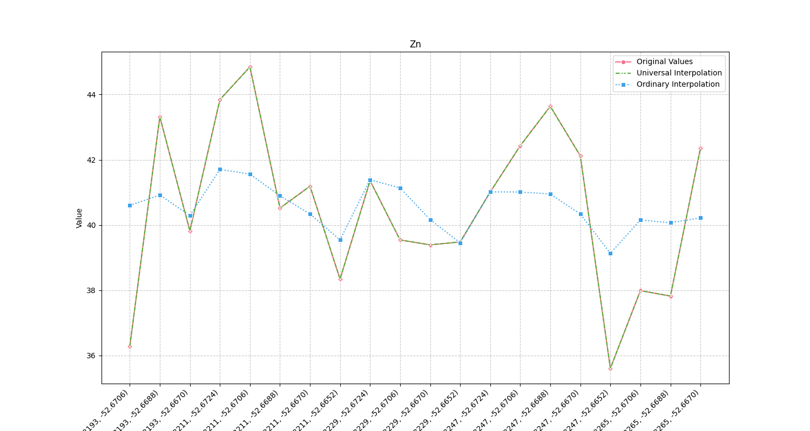
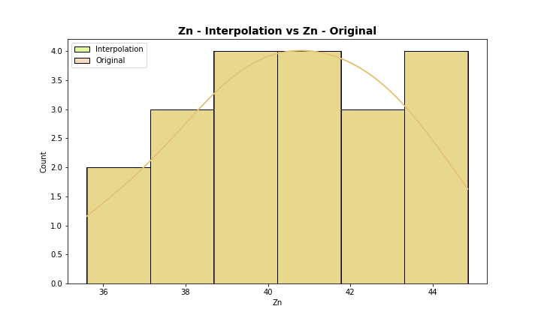
Analysis for column: Zn Model: UK
Interpolated Statistics:
mean 40.545252
std 2.541106
min 35.605859
25% 39.130434
50% 40.765474
75% 42.377728
80% 42.609560
85% 43.368553
90% 43.658575
95% 43.897497
99% 44.655070
Original Statistics:
mean 40.54450
std 2.54272
min 35.60000
25% 39.12750
50% 40.76500
75% 42.37750
80% 42.60800
85% 43.36800
90% 43.66000
95% 43.89050
99% 44.65810

Slide 12
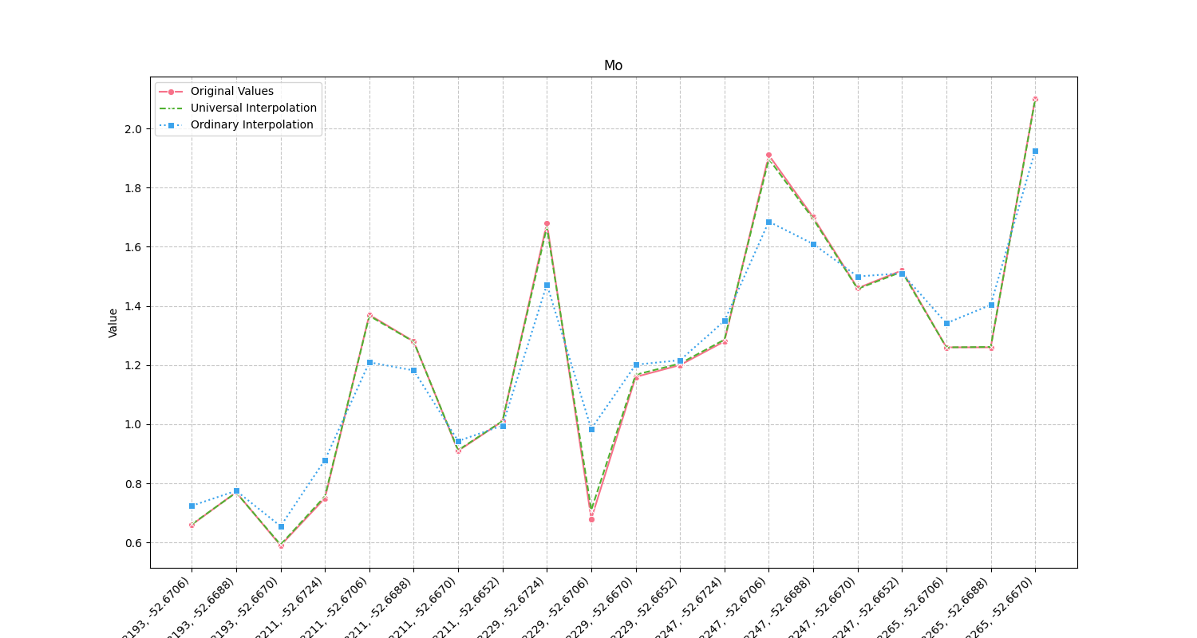
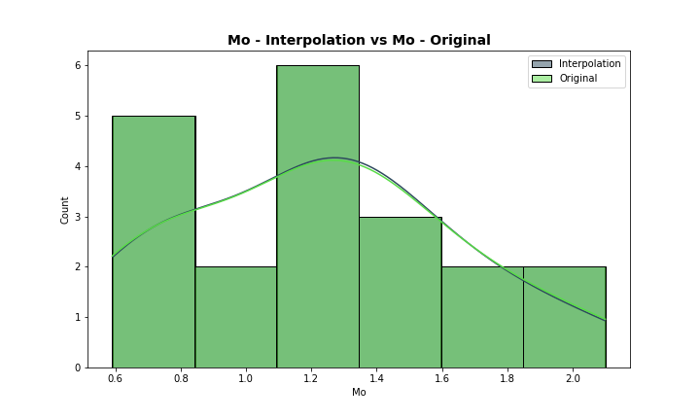
Analysis for column: Mo Model: UK
Interpolated Statistics:
mean 1.228335
std 0.420158
min 0.592736
25% 0.876358
50% 1.260648
75% 1.472095
80% 1.545956
85% 1.671235
90% 1.714521
95% 1.906947
99% 2.059554
Original Statistics:
mean 1.2275
std 0.4256
min 0.5900
25% 0.8750
50% 1.2600
75% 1.4750
80% 1.5520
85% 1.6830
90% 1.7210
95% 1.9195
99% 2.0639

Slide 13
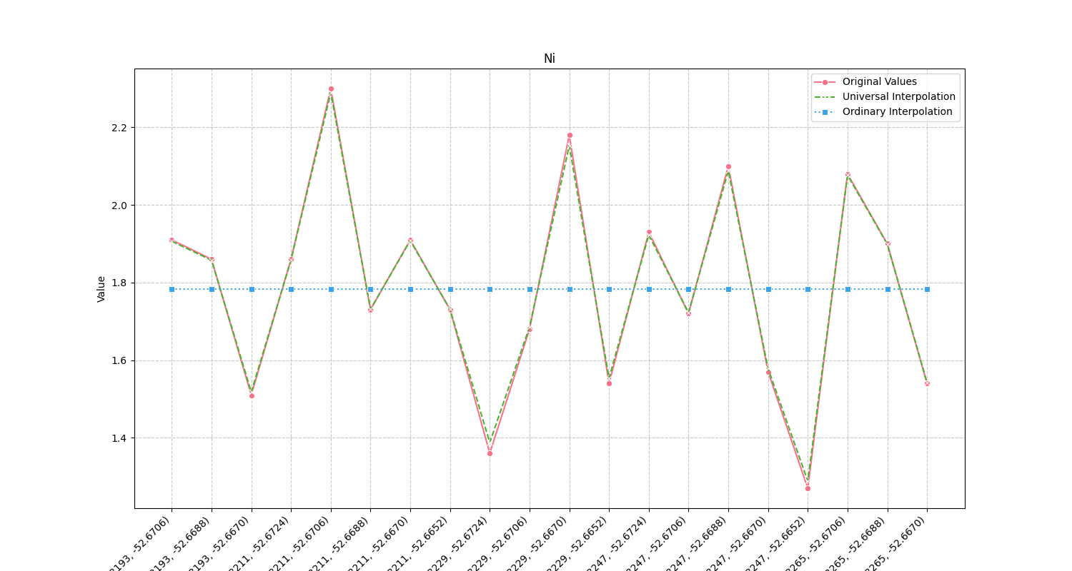
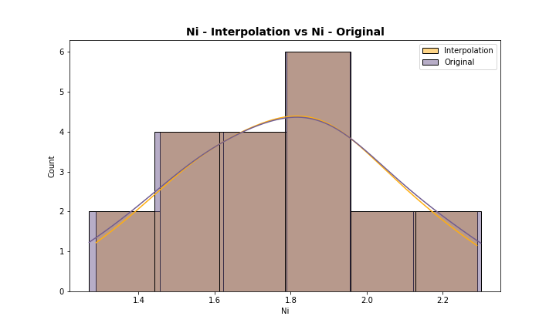
Analysis for column: Ni Model: UK
Interpolated Statistics:
mean 1.784896
std 0.260574
min 1.288344
25% 1.572416
50% 1.794492
75% 1.911805
80% 1.953585
85% 2.078299
90% 2.094383
95% 2.159911
99% 2.263723
Original Statistics:
mean 1.784000
std 0.270796
min 1.270000
25% 1.562500
50% 1.795000
75% 1.915000
80% 1.960000
85% 2.083000
90% 2.108000
95% 2.186000
99% 2.277200

Slide 14
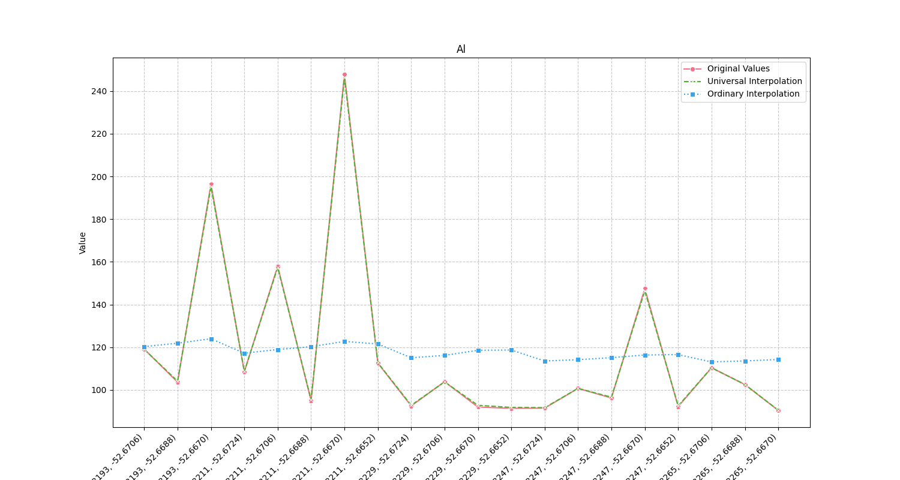
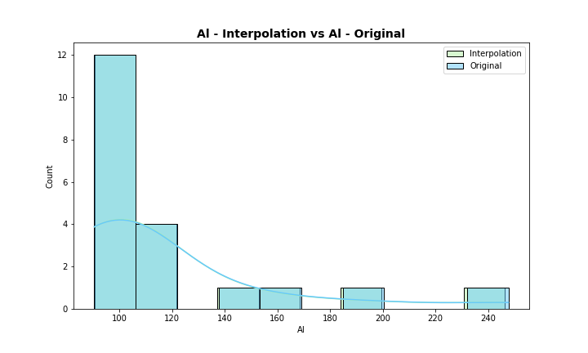
Analysis for column: Al Model: UK
Interpolated Statistics:
mean 117.567153
std 40.351753
min 90.483079
25% 92.809833
50% 103.139290
75% 114.311088
80% 124.484574
85% 148.088207
90% 161.183791
95% 197.822260
99% 236.648024
Original Statistics:
mean 117.593500
std 40.882932
min 90.400000
25% 92.415000
50% 103.070000
75% 114.200000
80% 124.788000
85% 149.036500
90% 161.815000
95% 198.988000
99% 238.021600

Slide 15
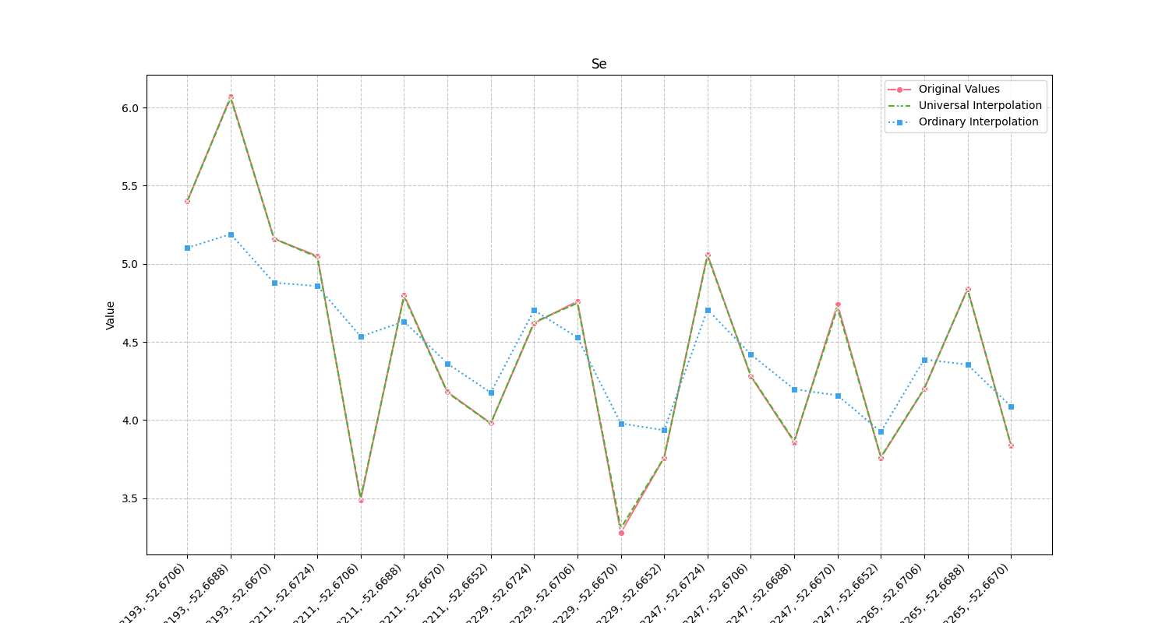
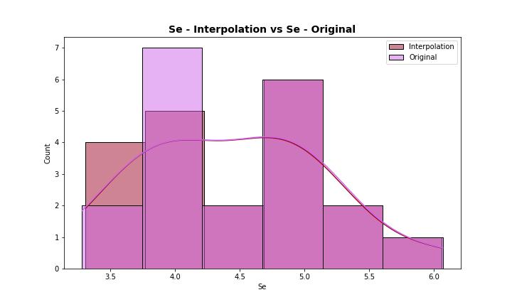
Analysis for column: Se Model: UK
Interpolated Statistics:
mean 4.456365
std 0.704434
min 3.308143
25% 3.860102
50% 4.455999
75% 4.888747
80% 5.044143
85% 5.068299
90% 5.185679
95% 5.434740
99% 5.936128
Original Statistics:
mean 4.456500
std 0.710599
min 3.280000
25% 3.855000
50% 4.450000
75% 4.892500
80% 5.052000
85% 5.075000
90% 5.184000
95% 5.433500
99% 5.942700

Slide 16
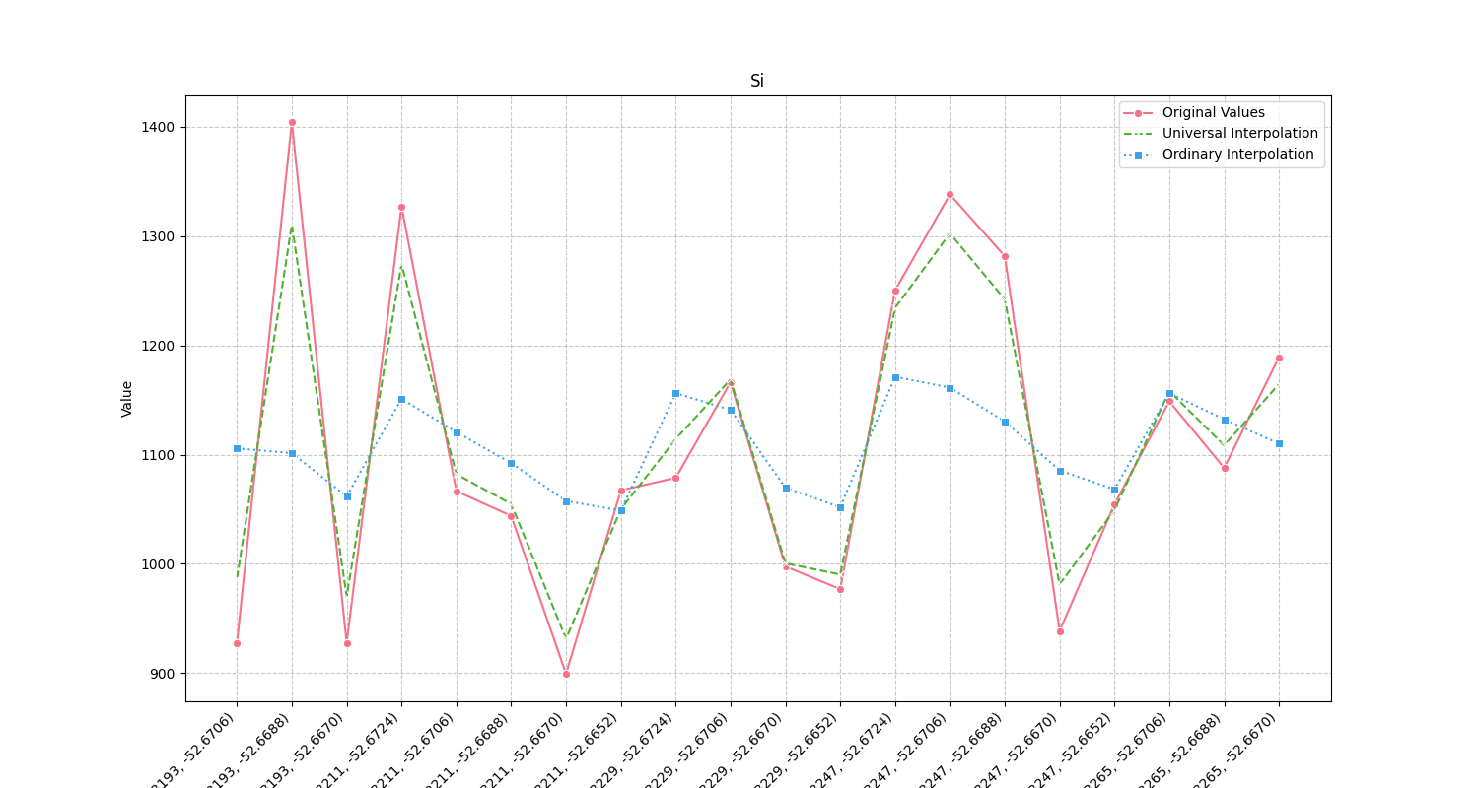
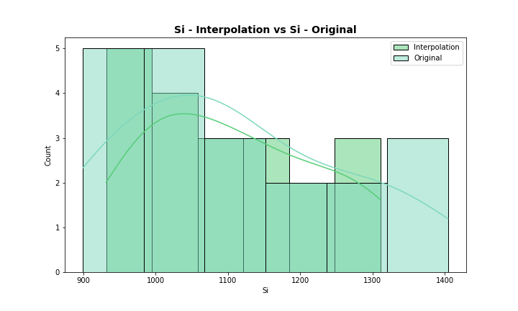
Analysis for column: Si Model: UK
Interpolated Statistics:
mean 1108.740366
std 118.470417
min 931.443482
25% 997.961657
50% 1095.282601
75% 1185.162655
80% 1235.844155
85% 1246.965403
90% 1277.257083
95% 1302.912854
99% 1309.120695
Original Statistics:
mean 1108.621500
std 150.260489
min 899.420000
25% 992.460000
50% 1073.010000
75% 1204.430000
80% 1256.702000
85% 1288.428500
90% 1328.269000
95% 1341.381000
99% 1391.708200

Slide 17
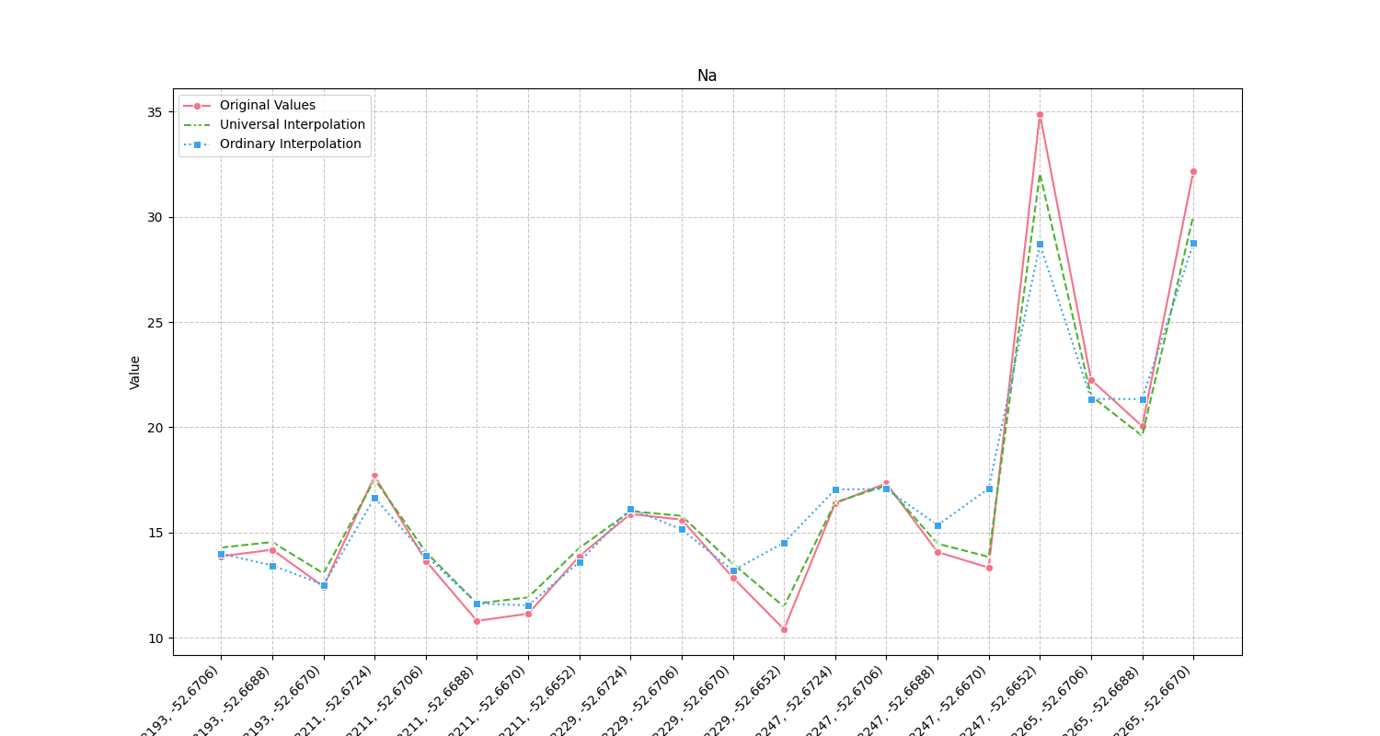
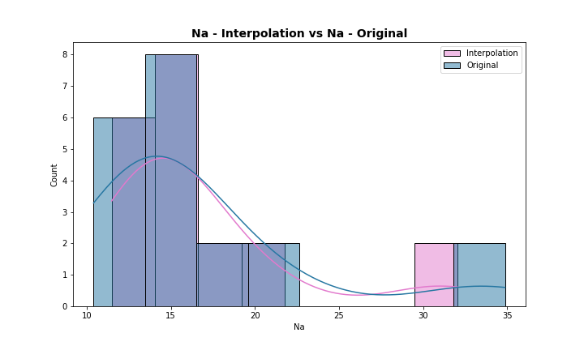
Analysis for column: Na Model: UK
Interpolated Statistics:
mean 16.663028
std 5.544388
min 11.476982
25% 13.759050
50% 14.506614
75% 17.306820
80% 17.942684
85% 19.873551
90% 22.348327
95% 30.164417
99% 31.682885
Original Statistics:
mean 16.642500
std 6.502053
min 10.400000
25% 13.212500
50% 14.125000
75% 17.425000
80% 18.154000
85% 20.381500
90% 23.250000
95% 32.296000
99% 34.363200

Slide 18
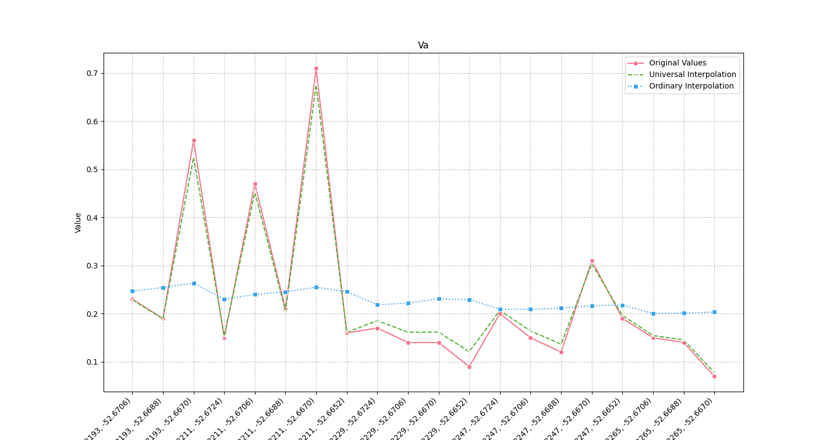
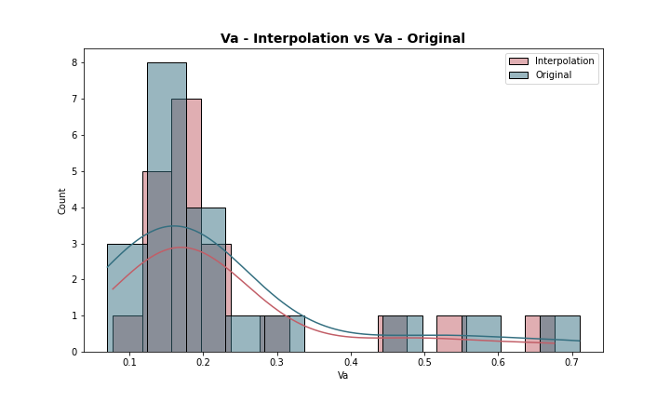
Analysis for column: Va Model: UK
Interpolated Statistics:
mean 0.230252
std 0.150049
min 0.077386
25% 0.154319
50% 0.174771
75% 0.212193
80% 0.243681
85% 0.326057
90% 0.459631
95% 0.532596
99% 0.647194
Original Statistics:
mean 0.227500
std 0.164952
min 0.070000
25% 0.140000
50% 0.165000
75% 0.215000
80% 0.246000
85% 0.334000
90% 0.479000
95% 0.567500
99% 0.681500

Slide 19
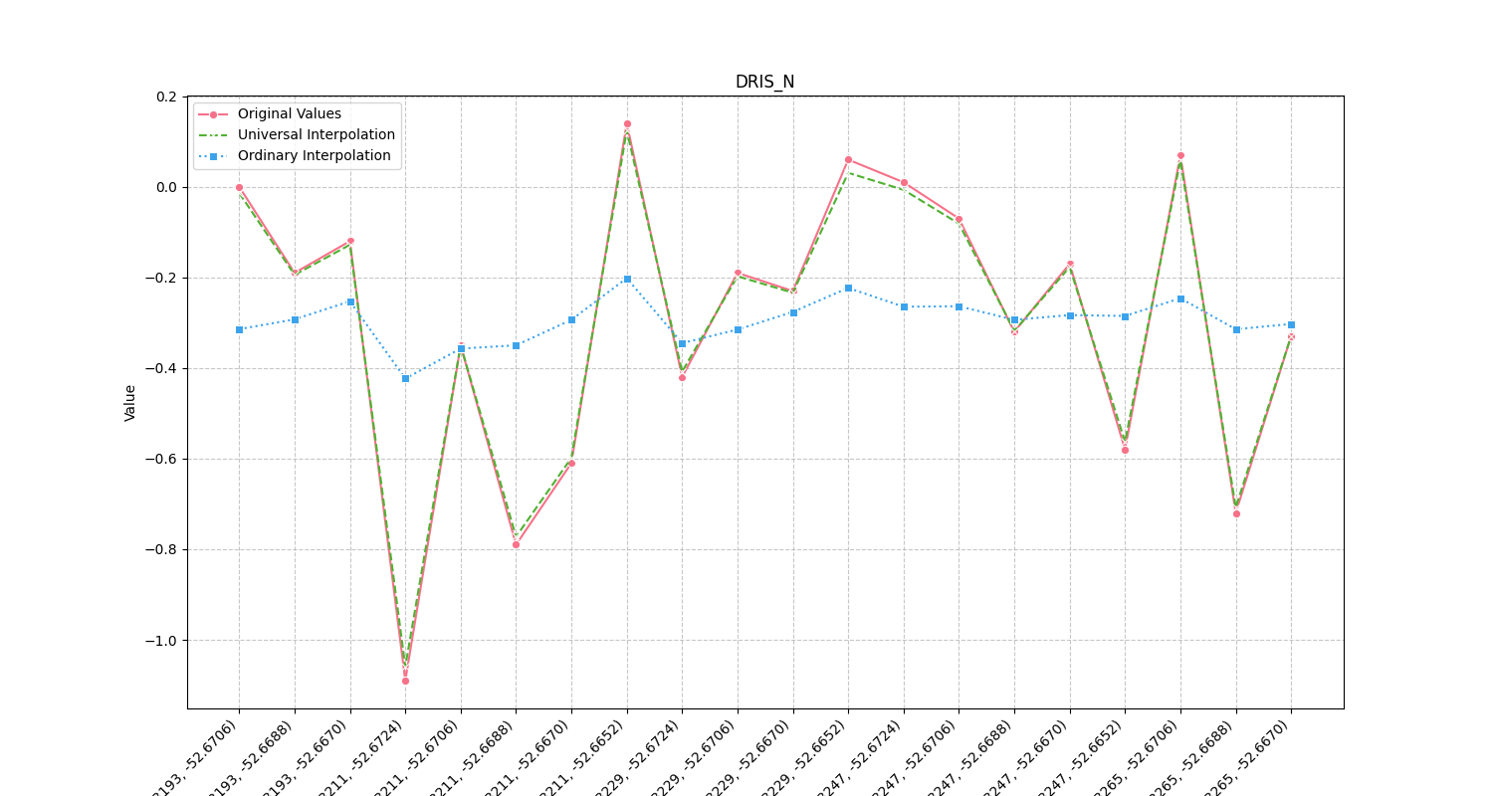
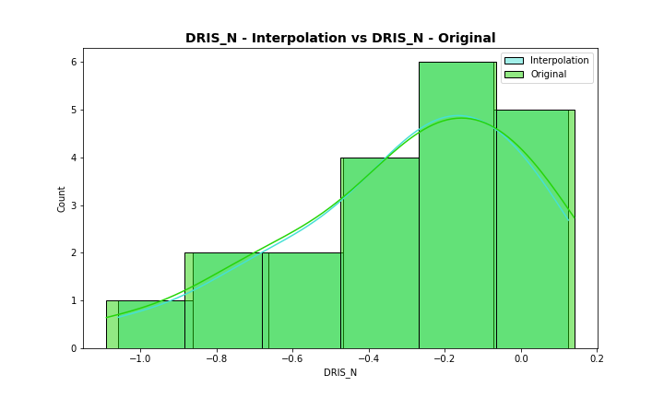
Analysis for column: DRIS_N Model: UK
Interpolated Statistics:
mean -0.296190
std 0.311525
min -1.059283
25% -0.446704
50% -0.215642
75% -0.064524
80% -0.012434
85% -0.001082
90% 0.033569
95% 0.062071
99% 0.112145
Original Statistics:
mean -0.295000
std 0.325277
min -1.090000
25% -0.460000
50% -0.210000
75% -0.052500
80% 0.002000
85% 0.017500
90% 0.061000
95% 0.073500
99% 0.126700

Slide 20
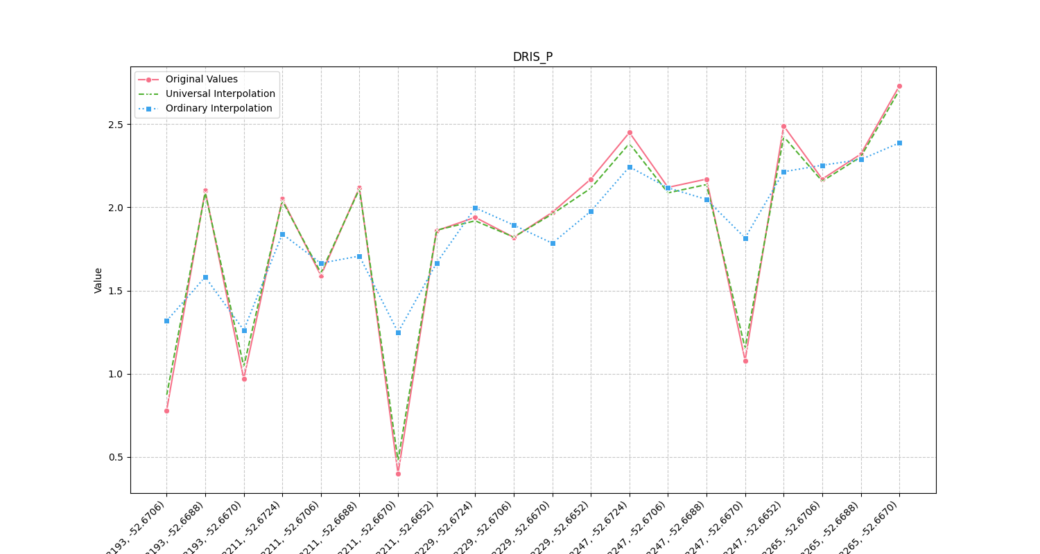
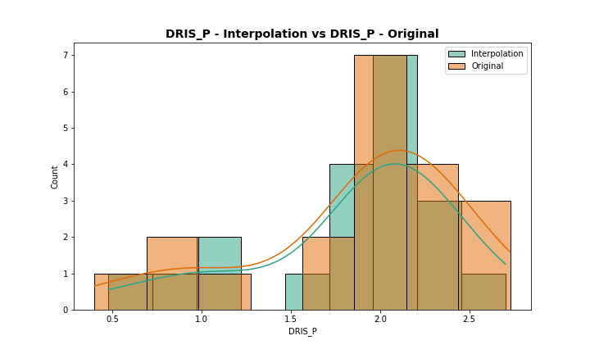
Analysis for column: DRIS_P Model: UK
Interpolated Statistics:
mean 1.863392
std 0.565106
min 0.477747
25% 1.767885
50% 2.063329
75% 2.142063
80% 2.186442
85% 2.315872
90% 2.388147
95% 2.439199
99% 2.651411
Original Statistics:
mean 1.865000
std 0.607917
min 0.400000
25% 1.762500
50% 2.075000
75% 2.170000
80% 2.200000
85% 2.339500
90% 2.454000
95% 2.502000
99% 2.684400

Slide 21
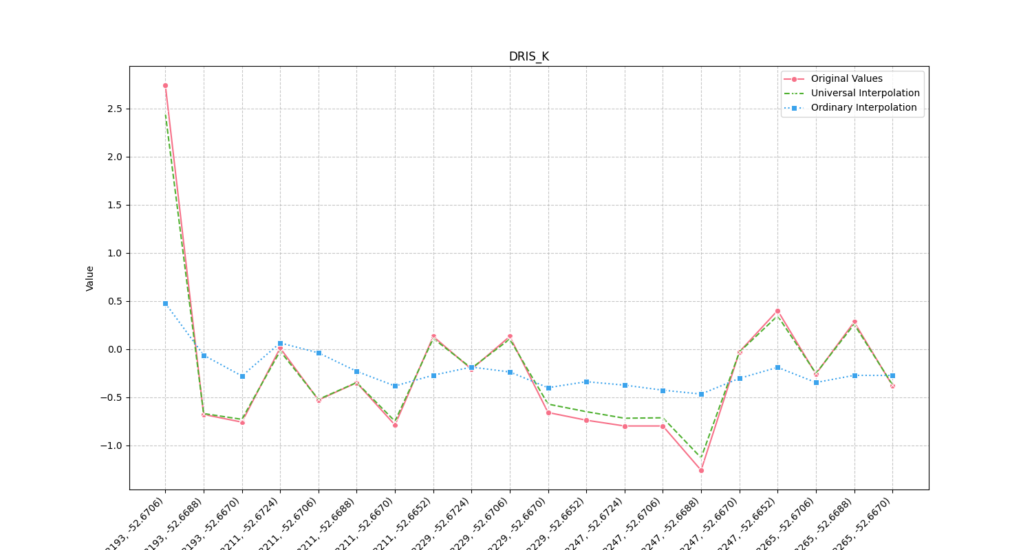
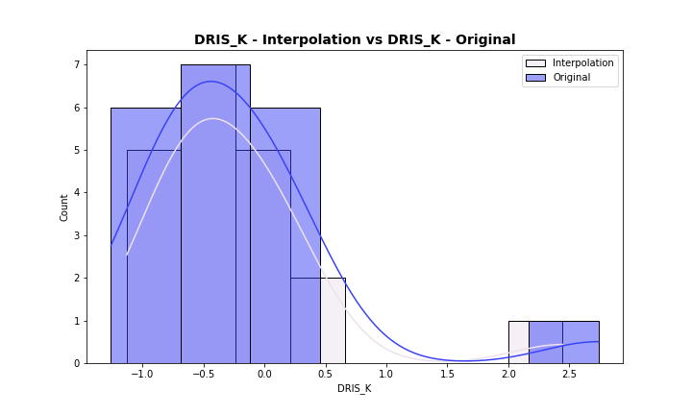
Analysis for column: DRIS_K Model: UK
Interpolated Statistics:
mean -0.221656
std 0.741898
min -1.130511
25% -0.682051
50% -0.360222
75% 0.009437
80% 0.103780
85% 0.131421
90% 0.265569
95% 0.449774
99% 2.047246
Original Statistics:
mean -0.228000
std 0.824478
min -1.260000
25% -0.745000
50% -0.365000
75% 0.040000
80% 0.130000
85% 0.152500
90% 0.292000
95% 0.517000
99% 2.295400

Slide 22
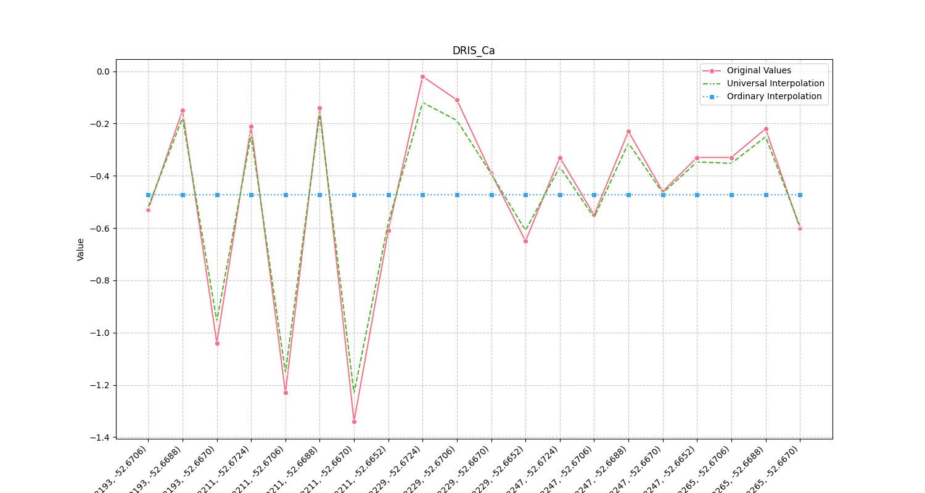
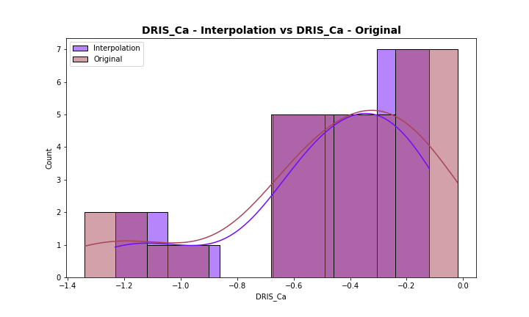
Analysis for column: DRIS_Ca Model: UK
Interpolated Statistics:
mean -0.477177
std 0.316526
min -1.232445
25% -0.582306
50% -0.379243
75% -0.249278
80% -0.232446
85% -0.186828
90% -0.176680
95% -0.161029
99% -0.127982
Original Statistics:
mean -0.473500
std 0.365229
min -1.340000
25% -0.602500
50% -0.360000
75% -0.217500
80% -0.198000
85% -0.148500
90% -0.137000
95% -0.105500
99% -0.037100

Slide 23
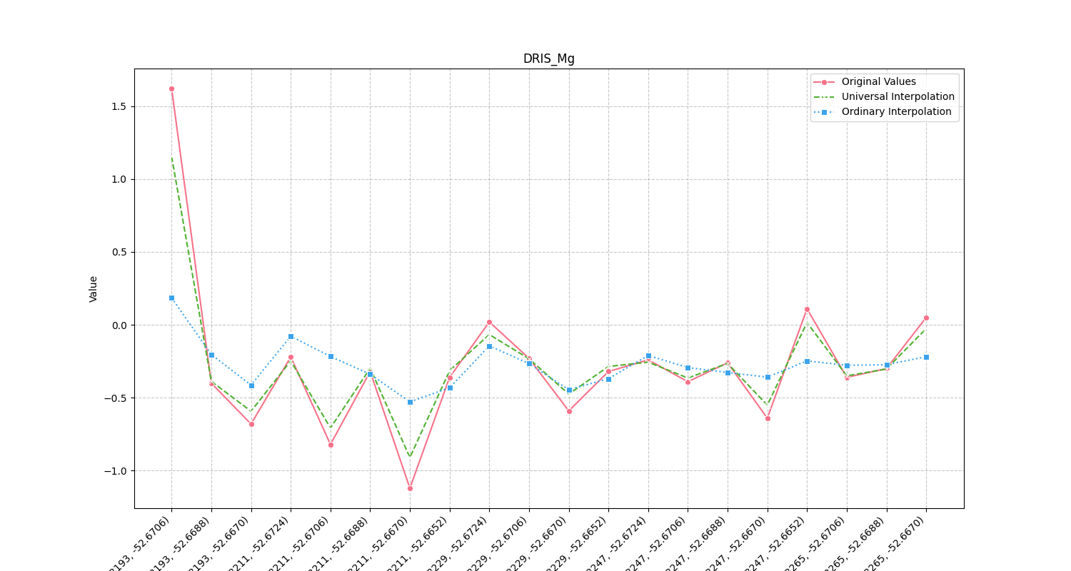
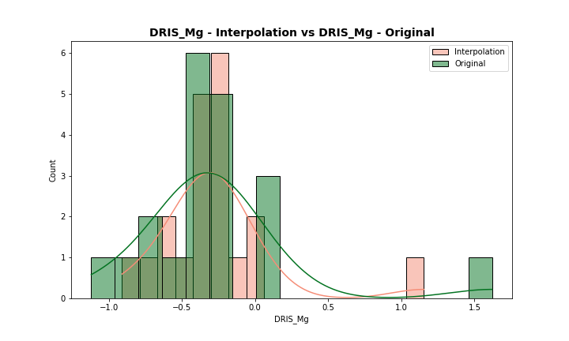
Analysis for column: DRIS_Mg Model: UK
Interpolated Statistics:
mean -0.272941
std 0.402004
min -0.909355
25% -0.409528
50% -0.300219
75% -0.243956
80% -0.199648
85% -0.060493
90% -0.021709
95% 0.072690
99% 0.938063
Original Statistics:
mean -0.272500
std 0.532807
min -1.120000
25% -0.447500
50% -0.320000
75% -0.227500
80% -0.172000
85% 0.024500
90% 0.056000
95% 0.185500
99% 1.333100

Slide 24
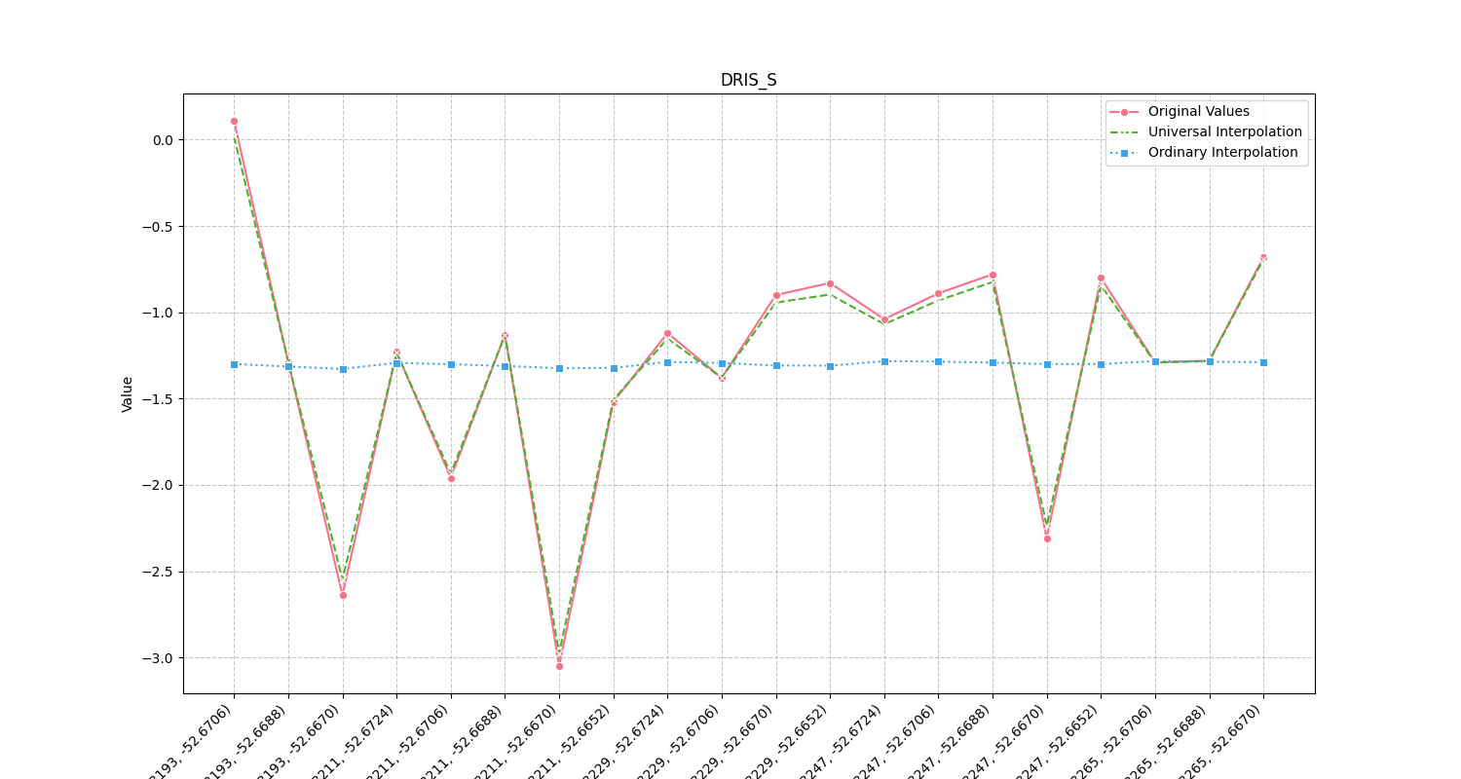
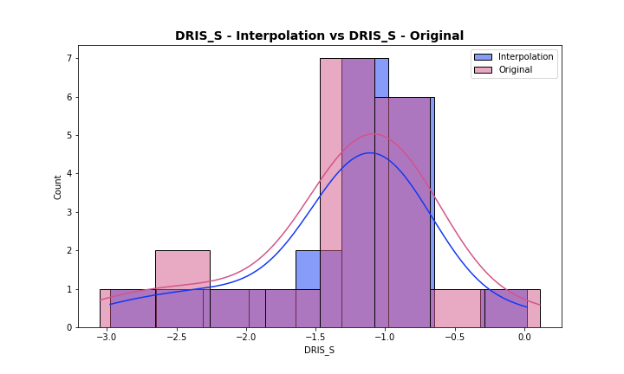
Analysis for column: DRIS_S Model: UK
Interpolated Statistics:
mean -1.307329
std 0.679607
min -2.977438
25% -1.410807
50% -1.193509
75% -0.922761
80% -0.886265
85% -0.839958
90% -0.811164
95% -0.657104
99% -0.117475
Original Statistics:
mean -1.300500
std 0.723475
min -3.050000
25% -1.415000
50% -1.180000
75% -0.875000
80% -0.824000
85% -0.797000
90% -0.770000
95% -0.640500
99% -0.040100

Slide 25
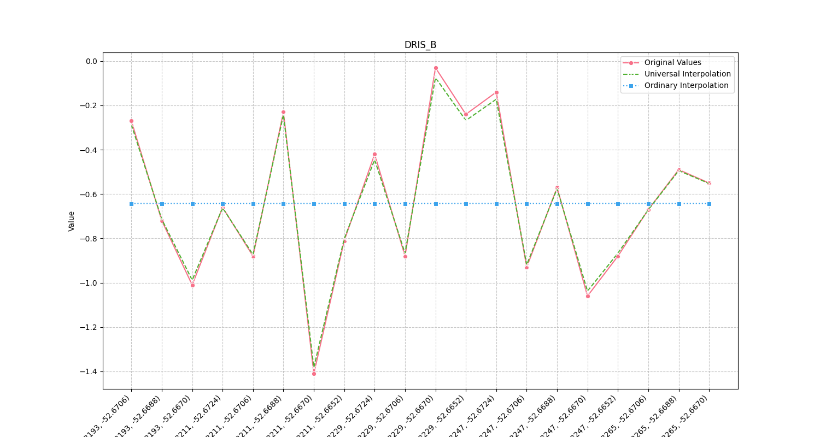
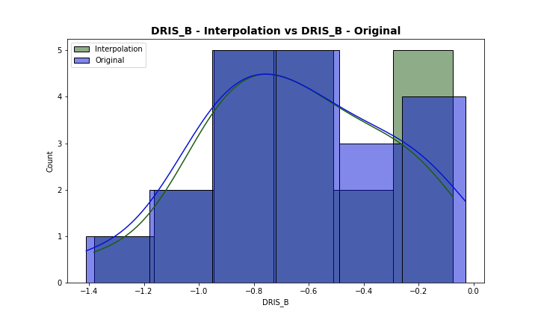
Analysis for column: DRIS_B Model: UK
Interpolated Statistics:
mean -0.644595
std 0.334826
min -1.382106
25% -0.868786
50% -0.666391
75% -0.405162
80% -0.282918
85% -0.263950
90% -0.234663
95% -0.167300
99% -0.093111
Original Statistics:
mean -0.642500
std 0.353224
min -1.410000
25% -0.880000
50% -0.665000
75% -0.382500
80% -0.264000
85% -0.238500
90% -0.221000
95% -0.134500
99% -0.050900

Slide 26


Analysis for column: DRIS_Cu Model: UK
Interpolated Statistics:
mean -2.546871
std 0.615567
min -3.373840
25% -2.949181
50% -2.610971
75% -2.418809
80% -2.301422
85% -2.168909
90% -2.104899
95% -1.783576
99% -0.741498
Original Statistics:
mean -2.546000
std 0.661198
min -3.430000
25% -2.972500
50% -2.610000
75% -2.420000
80% -2.292000
85% -2.126500
90% -2.028000
95% -1.754000
99% -0.598800

Slide 27


Analysis for column: DRIS_Fe Model: UK
Interpolated Statistics:
mean 1.815648
std 2.335980
min -1.442738
25% 0.867827
50% 1.014873
75% 1.187236
80% 1.734185
85% 3.881121
90% 4.243062
95% 6.573494
99% 8.504867
Original Statistics:
mean 1.78800
std 2.49472
min -1.71000
25% 0.81500
50% 0.94500
75% 1.11500
80% 1.76400
85% 4.06600
90% 4.37300
95% 6.95550
99% 8.86310

Slide 28


Analysis for column: DRIS_Mn Model: UK
Interpolated Statistics:
mean 1.229655
std 0.419836
min -0.248420
25% 1.101995
50% 1.249288
75% 1.414591
80% 1.538170
85% 1.673737
90% 1.686872
95% 1.690124
99% 1.690464
Original Statistics:
mean 1.232500
std 0.571166
min -0.770000
25% 1.047500
50% 1.265000
75% 1.457500
80% 1.610000
85% 1.782000
90% 1.854000
95% 1.891500
99% 1.914300

Slide 29


Analysis for column: DRIS_Zn Model: UK
Interpolated Statistics:
mean 0.449106
std 0.706271
min -2.370276
25% 0.514811
50% 0.589277
75% 0.796575
80% 0.824392
85% 0.842815
90% 0.850928
95% 0.859731
99% 0.868233
Original Statistics:
mean 0.448500
std 0.706252
min -2.370000
25% 0.515000
50% 0.590000
75% 0.797500
80% 0.824000
85% 0.841500
90% 0.851000
95% 0.860500
99% 0.868100

Slide 30


Analysis for column: IMS Model: UK
Interpolated Statistics:
mean 0.487961
std 0.402695
min -0.217634
25% 0.442967
50% 0.498545
75% 0.550472
80% 0.566435
85% 0.580155
90% 0.598331
95% 0.727541
99% 1.686669
Original Statistics:
mean 0.489500
std 0.424419
min -0.240000
25% 0.440000
50% 0.500000
75% 0.562500
80% 0.572000
85% 0.583000
90% 0.607000
95% 0.737000
99% 1.755400

Slide 31


Analysis for column: IBN Model: UK
Interpolated Statistics:
mean 12.117573
std 3.614276
min 1.690114
25% 10.861991
50% 11.876546
75% 12.892608
80% 13.212138
85% 13.637006
90% 15.339873
95% 17.775841
99% 20.561302
Original Statistics:
mean 12.084000
std 3.777432
min 1.190000
25% 10.797500
50% 11.860000
75% 12.907500
80% 13.248000
85% 13.701000
90% 15.449000
95% 18.054000
99% 20.850800

